Slide 1
Applying the Autonomy Approach to L2 literacy development
Brian R. Morrison
Kanda University of International Studies, Japan
morrison_brian@yahoo.com
http://kandaeli.academia.edu/BobMorrison

Slide 2
Overview
The Autonomy Approach
The Context
Self-directed learning modules
The learner
The study
Findings
Semester 1
Semester 2
Semester 3

Slide 3
The Autonomy Approach

Slide 4
Context
Self-Access Centre
Pedagogic support

Slide 5
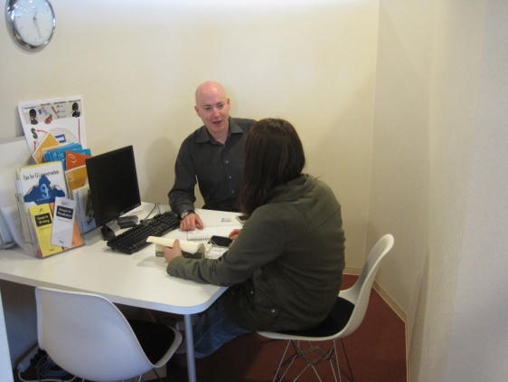
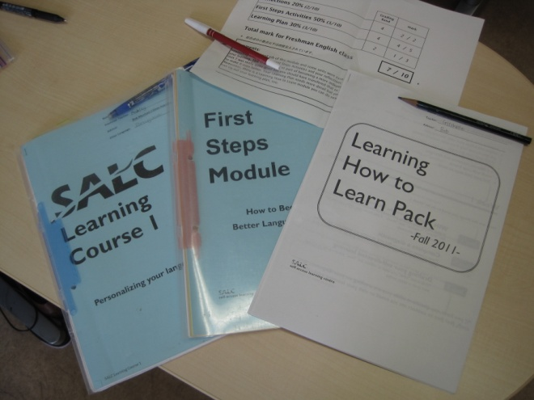
Context: Pedagogic support
Writing centre
Learning Advisors
Self-access curriculum

Slide 6
Context: Structured self-directed language learning (SDLL) curriculum
 | Modules
1st year | Learner training module
 | SDLL module
2nd year | SDLL module
 | SDLL module

Slide 7
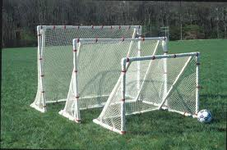
Context: SDLL module
Choose a focused goal

Slide 8
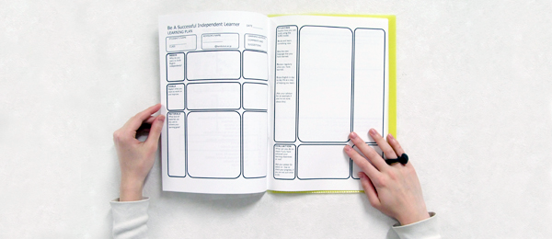
Context: SDLL module
Create a learning plan

Slide 9
Context: SDLL module
Implement the learning plan
Record learning activities & reflect

Slide 10
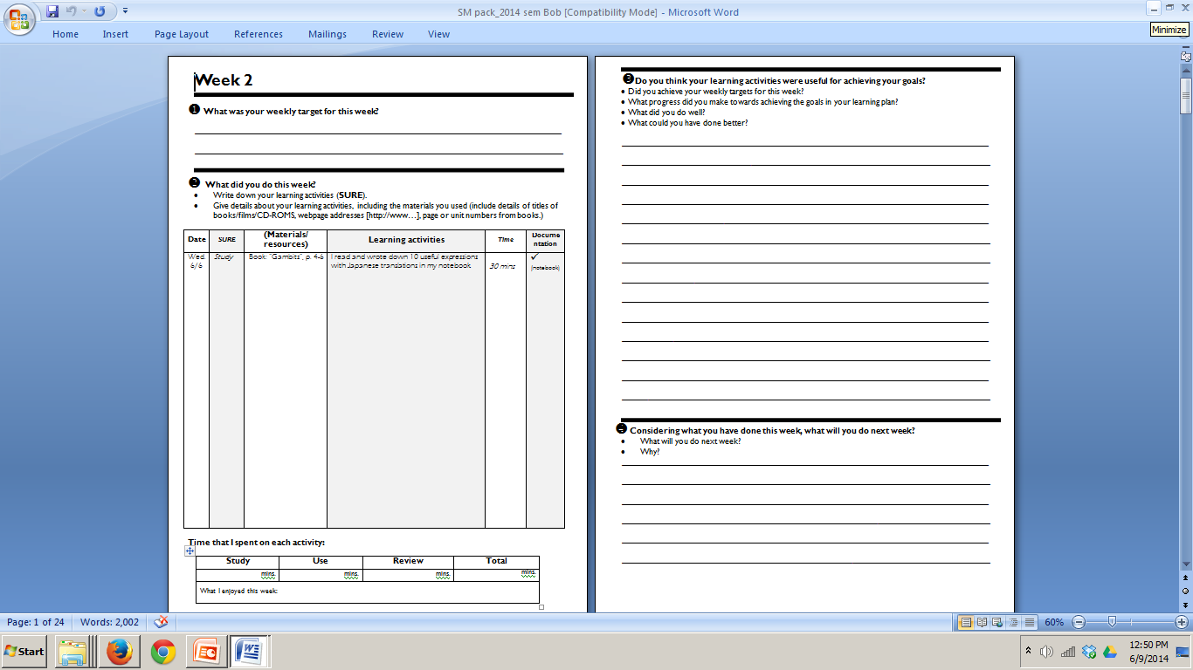
Context: SDLL module
Guided reflection & evaluation

Slide 11
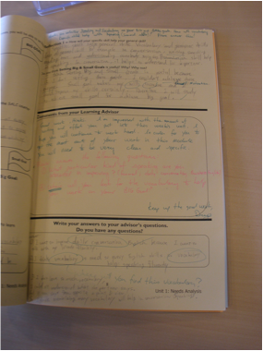
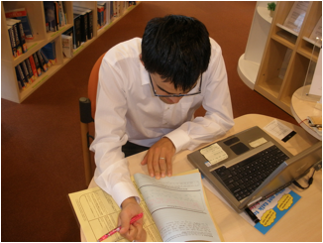
SDLL module
Receive weekly feedback

Slide 12
SDLL module
Initial face-to-face advising session

Slide 13
SDLL module
Face-to-face advising session mid-module

Slide 14
SDLL module
Final advising session & report

Slide 15
The learner
Undergraduate
Longitudinal
Focus on writing
No relevant writing classes
Made exceptional progress
Investigation could inform practice

Slide 16
The study
Research questions
What did she do to improve her writing?
Were there any challenges?
How were these overcome?

Slide 17
The study
Methodology
Document analysis
Analyse through a Prepare-Use-Review framework
Prepare – increase language knowledge
Use – implement the language knowledge within the target skill
Review – check the language knowledge remains and is being implemented appropriately

Slide 18
Case study: Part 1

Slide 19
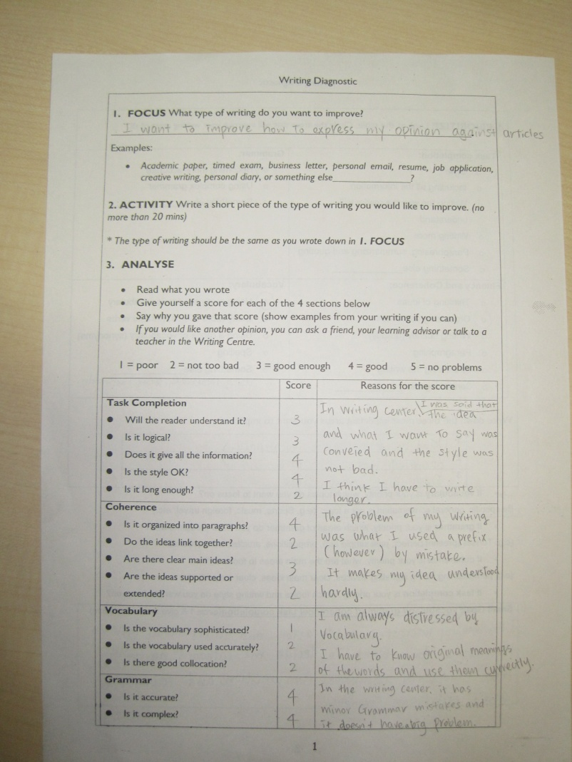
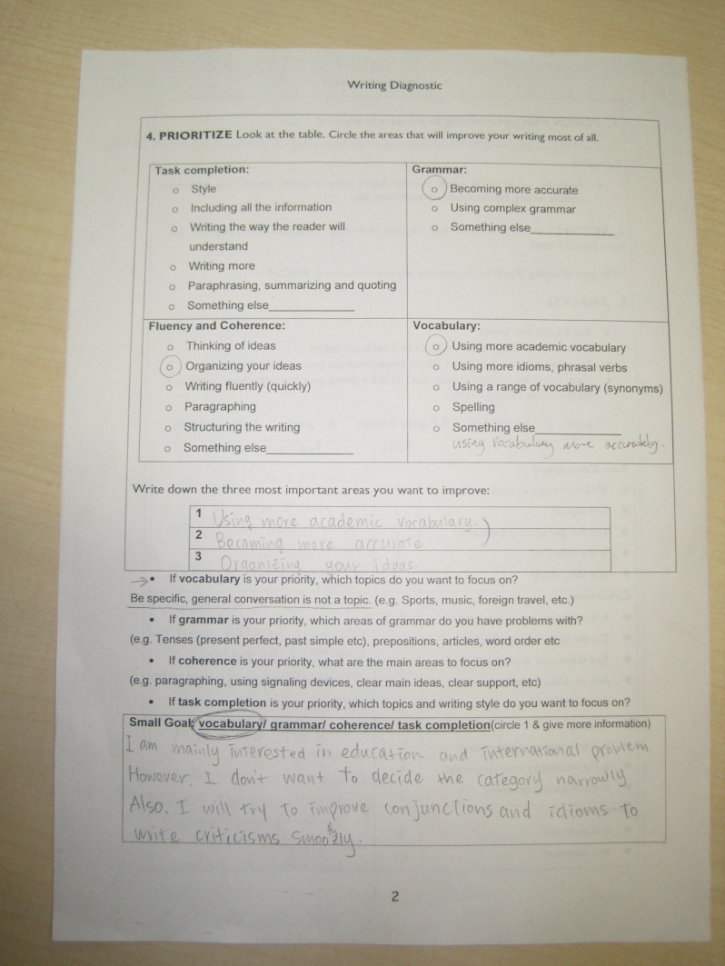
Case study: Semester 1
Choose a focused goal
Write my option about articles (critical essay writing)
Week 1

Slide 20
Case study
Week 1
Chose a focused goal
Develop academic vocabulary to write my option about articles (critical essay writing)

Slide 21
Case study
Create a learning plan

Slide 22
Case study Learning Plan Week 1
Prepare: Read an article; Pick out vocabulary from the article
Use: Write my opinion about the article and use vocabulary I pick out
Review: Rewrite after checking in the writing centre; Write down new vocabulary I have to know

Slide 23
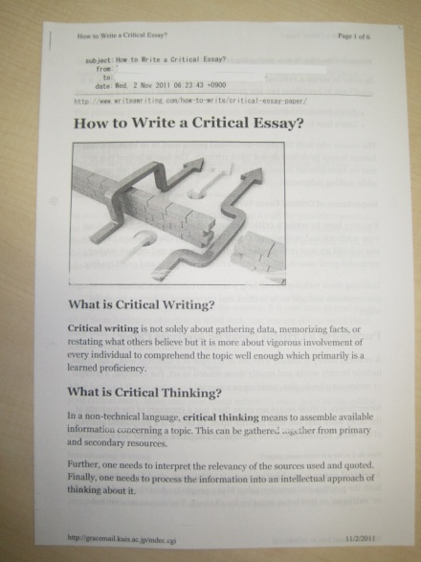
Case study
Implement the learning plan Week 2
Notes:
First of all I analyzed how to write a critical essay. Also I took some advise from Teacher G and Teacher J [in the writing centre]

Slide 24
Case study Learning Plan Week 2
Prepare: Read an article; Pick out vocabulary from the article
Use: Write my opinion about the article and use vocabulary I pick out
Review: Rewrite after checking in the writing centre; Write down new vocabulary I have to know
Prepare: Research how to write

Slide 25
Case study
Reflection & LA response Week 2
I need to search more information on topic
My basic academic vocabulary is problem and I don’t know how introduce my ideas
OK, so maybe signposting phrases and paragraph transitions – have you seen www.phrasebank.manchester.ac.uk
I cannot make structure properly
How can you find out how to do this properly?
I will find other examples and read some advice how to write critical writing

Slide 26
Case study Learning Plan Week 3
Prepare: Read an article; Pick out vocabulary from the article
Use: Write my opinion about the article and use vocabulary I pick out
Review: Rewrite after checking in the writing centre; Write down new vocabulary I have to know
Prepare: Research how to write
Prepare: Search for more information on the topic

Slide 27
Case study
Modify the learning plan Week 3
I will review my two critical writings I’ve already written because I want to make them clearly.
I will find some examples and think how to write them more effectively.
Where will you find good examples?
I tried to find good examples and found some but I think these are not enough to help me write clearly
I’ve already been using the website you told me because LA suggested last term. The usage is a little awkward.

Slide 28
Case study Learning Plan Week 4
Prepare: Read an article; Pick out vocabulary from the article
Use: Write my opinion about the article and use vocabulary I pick out
Review: Rewrite after checking in the writing centre; Write down new vocabulary I have to know
Prepare: Research how to write
Prepare: Search for more information on the topic
Prepare: Search for good exemplars

Slide 29
Case study Learning Plan Week 4
Prepare: Read an article; Pick out vocabulary from the article
Use: Write my opinion about the article and use vocabulary I pick out
Review: Rewrite after checking in the writing centre; Write down new vocabulary I have to know
Prepare: Research how to write
Prepare: Search for more information on the topic
Prepare: Search for good examplars
Review: Made notes of previous mistakes

Slide 30
Learning How to Learn module
LA response Week 4
You might think about selecting phrases from your final draft that could be recycles and reused in future writing – create your own phrase bank
What do you think?
I was impressed at your advice. I agree with you and I’ll try to produce my own phrasebank

Slide 31
Advising session
when to stop writing drafts
focus on errors

Slide 32
Case study Learning Plan Week 5
Prepare: Read an article; Pick out vocabulary from the article
Use: Write my opinion about the article and use vocabulary I pick out
Review: Rewrite after checking in the writing centre; Write down new vocabulary I have to know
Prepare: Research how to write
Prepare: Search for more information on the topic
Prepare: Search for good exemplars
Review: Made notes of previous mistakes
Review: Make notes of previous success

Slide 33
Case study
Reflect Week 5
Reading final drafts
There were much more vocabulary than I expected
Creating a table of phrases
I made a table and added some example to make it easier to use
I could look back on my studying and consider how to write better and save time writing. I am likely to write the next essay much better ☺
Discussed useful phrases and usage with teacher J
It makes my grammar and how to write sentences more obvious

Slide 34
Case study Learning Plan Week 6
Prepare: Read an article; Pick out vocabulary from the article
Use: Write my opinion about the article and use vocabulary I pick out
Review: Rewrite after checking in the writing centre; Write down new vocabulary I have to know
Prepare: Research how to write
Prepare: Search for more information on the topic
Prepare: Search for good exemplars
Review: Made notes of previous mistakes
Review: Make notes of previous success

Slide 35
Case study
Reflect Week 6
Wrote a critical essay with my phrasebank
This article was easy to write. I could structure and frame my paragraphs easily. Also I wrote smoothly when I referred to my organized list.
Took the essay to the writing centre twice for feedback from teacher J & teacher G
Teacher G said except for small parts, it’s like an article by a Freshman Canadian university student. I was really happy to hear that.
Teacher J also said that the structure and ideas were excellent. So, I can concentrate on grammar and vocabulary. I also think I worked out without big trouble and wrote quickly ☺

Slide 36
Case study Learning Plan Week 7
Prepare: Read an article; Pick out vocabulary from the article
Use: Write my opinion about the article and use vocabulary I pick out
Review: Rewrite after checking in the writing centre; Write down new vocabulary I have to know
Prepare: Research how to write
Prepare: Search for more information on the topic
Prepare: Search for good exemplars
Review: Made notes of previous mistakes
Review: Make notes of previous success

Slide 37
Case study
Reflect Week 7
Read many websites to understand the new article topic(Black Friday, Thanksgiving Day & industrial dispute)
This topic was hard. Although I could understand the topic at the end I didn’t know about Black Friday and the social problems so I couldn’t make my idea clearly and organize my ideas.
Read new article carefully
Organized new words in notebook
Wrote my paper
The last time I wrote quickly and smoothly without outline but I noticed that the outline is important in this case

Slide 38
Case study Learning Plan Week 8
Prepare: Read an article; Pick out vocabulary from the article
Use: Write my opinion about the article and use vocabulary I pick out
Review: Rewrite after checking in the writing centre; Write down new vocabulary I have to know
Prepare: Research how to write
Prepare: Search for more information on the topic
Prepare: Search for good exemplars
Review: Made notes of previous mistakes
Review: Make notes of previous success

Slide 39
Case study
Reflect Week 8
Teacher J. said the last paragraph I wrote this week is the best one I have ever written. He said no one would ever imagine this was written by someone who was not an English speaker also the ideas were really good.
I couldn’t expect my writing skill would be improved so much as now. I am very satisfied with my work and I am pleased that I was able to finish module as I planned at the beginning. ☺

Slide 40
Summary of strategies
Research how to write
Search for good exemplars
Seek feedback
Find out how to improve the writing
Redraft
Make notes of mistakes
Make notes of language emerging from redrafts
Recycle language in future written work

Slide 41
Summary of challenges
A lack of topic knowledge
Focusing on required changes
Knowing when to stop re-drafting
Identifying good exemplars

Slide 42
Strategies to overcome challenges
A lack of topic knowledge
Find more information on a topic
Writing an outline
Focusing on required changes
Identify what is good about the writing
Make notes of successful language use in final drafts
Knowing when to stop re-drafting
Consider the benefits of redrafting vs. starting a new piece of writing
Identifying good exemplars
Use final drafts as good exemplars

Slide 43
Intermission
Any comments?
Any questions?

Slide 44
Case study: Part 2

Slide 45
Case study
Week 1
Write my option about articles (critical essay writing)
Improve academic critical writing – writing about current affairs: international, national and business.
Focus on developing vocabulary (idioms)

Slide 46
Case study
Create a learning plan

Slide 47
Case study Learning Plan Week 1
Prepare: Read an article; Identify vocabulary
Read other articles and watch news for more topic information
Use: Write a summary and opinion about the article
Use new vocab.
Paragraph and use conjunctions to connect ideas and communicate clearly
Review: Rewrite after checking in the writing centre;
List the new vocabulary and useful idioms I used

Slide 48
Case study Learning Plan Week 2
Prepare: Read an article; Identify vocabulary
Read other articles and watch news for more topic information
Use: Write a summary and opinion about the article
Use new vocab.
Paragraph and use conjunctions to connect ideas and communicate clearly
Review: Rewrite after checking in the writing centre;
List the new vocabulary and useful idioms I used
Prepare: Use AWL generator to identify AW
Make a phrasebank
Use AWL books

Slide 49
Case study Learning Plan Week 3
Prepare: Read an article; Identify vocabulary
Read other articles and watch news for more topic information
Use: Write a summary and opinion about the article
Use new vocab.
Paragraph and use conjunctions to connect ideas and communicate clearly
Review: Rewrite after checking in the writing centre;
List the new vocabulary and useful idioms I used
Prepare: Search for synonyms & keep notes
Prepare: Use AWL generator to identify AW
Make a phrasebank
Use AWL books

Slide 50
Case study Learning Plan Week 4
Prepare: Read an article; Identify vocabulary
Read other articles and watch news for more topic information
Use: Write a summary and opinion about the article
Use new vocab.
Paragraph and use conjunctions to connect ideas and communicate clearly
Review: Rewrite after checking in the writing centre;
List the new vocabulary and useful idioms I used
Prepare: Search for synonyms & keep notes
Prepare: Use AWL generator to identify AW
Make a phrasebank
Use AWL books

Slide 51
Advising session
extending range of EAP writing
focus on errors

Slide 52
Case study Learning Plan Week 5
Prepare: Read an article; Identify vocabulary
Read other articles and watch news for more topic information
Use: Write a summary and opinion about the article
Use new vocab.
Paragraph and use conjunctions to connect ideas and communicate clearly
Review: Rewrite after checking in the writing centre;
List the new vocabulary and useful idioms I used
Prepare: Search for synonyms & keep notes
Prepare: Use AWL generator to identify AW
Make a phrasebank
Use AWL books
Prepare: Read an opposing article
Use: summarize and contrast 2 opposing article

Slide 53
Case study Learning Plan Week 6
Prepare: Read an article; Identify vocabulary
Read other articles and watch news for more topic information
Use: Write a summary and opinion about the article
Use new vocab.
Paragraph and use conjunctions to connect ideas and communicate clearly
Review: Rewrite after checking in the writing centre;
List the new vocabulary and useful idioms I used
Prepare: Search for synonyms & keep notes
Prepare: Use AWL generator to identify AW
Make a phrasebank
Use AWL books
Prepare: Read an opposing article
Use: summarize and contrast 2 opposing article

Slide 54
Case study Learning Plan Week 7
Prepare: Read an article; Identify vocabulary
Read other articles and watch news for more topic information
Use: Write a summary and opinion about the article
Use new vocab.
Paragraph and use conjunctions to connect ideas and communicate clearly
Review: Rewrite after checking in the writing centre;
List the new vocabulary and useful idioms I used
Prepare: Search for synonyms & keep notes
Prepare: Use AWL generator to identify AW
Make a phrasebank
Use AWL books
Prepare: Read an opposing article
Use: summarize and contrast 2 opposing article

Slide 55
Case study Week 7
Use
Rewriting article 4
Rewriting article 5
Writing an opinion about article 5 & 6
Review
Receiving feedback from writing centre on article 4
Receiving feedback from writing centre on article 5
Next week
Making summary 6 perfect and make the opinion about 5 & 6 complete.
Repairing (revising?) synonym & phrases bank

Slide 56
Case study Learning Plan Week 8
Prepare: Read an article; Identify vocabulary
Read other articles and watch news for more topic information
Use: Write a summary and opinion about 2 articles
Use new vocab.
Paragraph and use conjunctions to connect ideas and communicate clearly
Review: Rewrite after checking in the writing centre;
List the new vocabulary and useful idioms I used
Prepare: Search for synonyms & keep notes
Prepare: Use AWL generator to identify AW
Make a phrasebank
Use AWL books
Prepare: Read an opposing article
Review: Revise vocabulary lists

Slide 57
Summary of strategies
Find more information on a topic
Seek feedback
Find out how to improve the writing
Redraft
Make notes of mistakes
Make notes of language emerging from redrafts
Recycle language in future written work
Make notes of successful language use in final drafts
Consider the benefits of redrafting vs. starting a new piece of writing

Slide 58
Summary of challenges
Identifying useful lexis to learn
Extending the range of lexis
Extending the range of writing
Focusing on required changes

Slide 59
Strategies to overcome challenges
Identifying useful lexis to learn
Using AWL software
Extending the range of lexis
Identify and note synonyms for frequently used lexis
Make notes of successful language use
Evaluate the language notes
Revise language notes when necessary
Extending the range of writing
Find a topic with opposing views
Focusing on required changes
Identify what is good about the writing

Slide 60
Intermission
Any comments?
Any questions?

Slide 61
Case study: Part 3

Slide 62
Case study Week 1
Choose a focused goal
Summarizing 2 opposing views about a controversial subject with my view.
Increase academic vocabulary with collocations
Week 1

Slide 63
Case study Learning Plan Week 1
Prepare: Read 2 opposing articles;
Analyze & search for other topic knowledge;
Make notes of article vocabulary – add to list
Use: Summarize & write my opinion about the article
Find synonyms to avoid repetition
Rewrite after checking in the writing centre
Review: Check vocab lists at WC;
Get WC feedback on writing;
Write down new vocabulary from WC visit

Slide 64
Case study Learning Plan Week 2
Prepare: Read 2 opposing articles;
Analyze & search for other topic knowledge;
Make notes of article vocabulary – add to list
Use: Summarize & write my opinion about the article
Find synonyms to avoid repetition
Rewrite after checking in the writing centre
Review: Check vocab lists at WC;
Get WC feedback on writing;
Write down new vocabulary from WC visit

Slide 65
SDLL module
LA response Week 2
I see that you have spent time on your wordlists and they have explanations and synonyms. What are your thoughts about this activity?
Making lists takes about 30 minutes. It’s very hard work. However, I think it’s useful when summarizing and writing about the related topics.

Slide 66
Case study Learning Plan Week 3
Prepare: Read 2 opposing articles;
Analyze & search for other topic knowledge;
Make notes of article vocabulary – add to list
Use: Summarize & write my opinion about the article
Find synonyms to avoid repetition
Rewrite after checking in the writing centre
Review: Check vocab lists at WC;
Get WC feedback on writing;
Write down new vocabulary from WC visit

Slide 67
Case study Learning Plan Week 4
Prepare: Read 2 opposing articles;
Analyze & search for other topic knowledge;
Make notes of article vocabulary – add to list
Use: Summarize & write my opinion about the article
Find synonyms to avoid repetition
Rewrite after checking in the writing centre
Review: Check vocab lists at WC;
Get WC feedback on writing;
Write down new vocabulary from WC visit

Slide 68
Advising session
time management (pressure)
disappointment at progress

Slide 69
Case study Learning Plan Week 5
Prepare: Read 2 opposing articles; Analyze & search for other topic knowledge;
Make notes of article vocabulary – add to list
Use: Summarize & write my opinion about the article
Find synonyms to avoid repetition
Rewrite after checking in the writing centre
Review: Check vocab lists at WC;
Get WC feedback on writing;
Write down new vocabulary from WC visit
Review: Identify what is good
Consider how to recycle it
Evaluate Review all previous writing
Consider progress

Slide 70
Case study
Reflect Week 5
So, this time I gathered all my work since I was a freshman and saw my improvements. I found many improvements by doing this. I can say that now I know how to write and how to improve myself.

Slide 71
Case study
Week 5
Next week
Week 6 – write summaries
Week 7 – write opinions
Week 8 – Evaluate (everything)

Slide 72
Case study Learning Plan Week 6
Prepare: Read 2 opposing articles; Analyze & search for other topic knowledge;
Make notes of article vocabulary – add to list
Use: Summarize & write my opinion about the article
Find synonyms to avoid repetition
Rewrite after checking in the writing centre
Review: Check vocab lists at WC;
Get WC feedback on writing;
Write down new vocabulary from WC visit
Review: Identify what is good
Consider how to recycle it
Evaluate Review all previous writing
Consider progress
Prepare: Outline & schedule the work required

Slide 73
Case study Learning Plan Week 7
Prepare: Read 2 opposing articles; Analyze & search for other topic knowledge;
Make notes of article vocabulary – add to list
Use: Summarize & write my opinion about the article
Find synonyms to avoid repetition
Rewrite after checking in the writing centre
Review: Check vocab lists at WC;
Get WC feedback on writing;
Write down new vocabulary from WC visit
Review: Identify what is good
Consider how to recycle it
Evaluate Review all previous writing
Consider progress
Prepare: Outline & schedule the work required

Slide 74
Case study Learning Plan Week 8
Prepare: Read 2 opposing articles; Analyze & search for other topic knowledge;
Make notes of article vocabulary – add to list
Use: Summarize & write my opinion about the article
Find synonyms to avoid repetition
Rewrite after checking in the writing centre
Review: Check vocab lists at WC;
Get WC feedback on writing;
Write down new vocabulary from WC visit
Review: Identify what is good
Consider how to recycle it
Evaluate Review all previous writing
Consider progress
Prepare: Outline & schedule the work required

Slide 75
Summary of strategies
Find a topic with opposing views
Find more information on the topic
Seek feedback
Find out how to improve the writing
Redraft
Make notes of mistakes
Make notes of language emerging from redrafts
Recycle language in future written work
Identify and note synonyms for frequently used lexis
Make notes of successful language use
Evaluate the language notes
Revise language notes when necessary
Make notes of successful language use in final drafts
Consider the benefits of redrafting vs. starting a new piece of writing

Slide 76
Summary of challenges
Time pressure
Perception of minimal progress

Slide 77
Strategies to overcome challenges
Time pressure
Consider scheduling steps in the writing process
Perception of minimal progress
Review all previous writing to evaluate overall progress
Evaluate knowledge depth and other aspects of quality

Slide 78
Thank you for listening
Any questions?
Brian R. Morrison
Kanda University of International Studies, Japan
morrison_brian@yahoo.com
http://kandaeli.academia.edu/BobMorrison

Slide 79
Summary of strategies
Research how to write
Find more information on a topic
Find opposing views on a topic
Search for good exemplars
Seek feedback
Find out how to improve the writing
Identify what is already good about the writing
Evaluate the feedback
Redraft
Consider the benefits of redrafting vs. the benefits of starting a new piece of writing
Make notes of mistakes
Consider how to identify useful language to learn e.g. synonyms
Make notes of language emerging from redrafts
Make notes of successful language use
Evaluate the language notes
Revise language notes when necessary
Consider how to recycle language in future written work
Use final drafts as good exemplars
Consider writing an outline
Consider scheduling steps in the writing process
Review all previous writing to evaluate overall progress
Evaluate knowledge depth and other aspects of quality

